Slide 1


- Making Travel easier
Reisen

Slide 2


Team Members
Kumari Puja | 2100985 | puja.k@northeastern.edu
Rashmi Singh | 2969333 | singh.ras@northeastern.edu
Sree Achyutha Varma Penmetcha | 2960283 | penmetcha.s@northeastern.edu
Hemanth Reddy Yaramala | 2922147 | yaramala.h@northeastern.edu
Sagar Khandagale | 2197761 | khndagale.s@northeastern.edu
Vivek Mannva | 2921511 | mannava.v@northeastern.edu

Slide 3
OUR Logo

Slide 4

Product Objectives
To deliver an adventurous and cheerful holiday experience to all age groups and provide expeditions and memories that would satisfy each customer.
To provide consumers with rates and vacation packages that include rental cars, travel flight tickets, accommodation services, etc.
To provide consumers with destination recommendations with respect to the seasons.
To provide a stress-free vacation experience to the consumers by providing essential services all in a single package.
To provide offers to special users based on their travel history with us.
To provide a simple user-friendly registration process for the consumers.
To provide travel recommendations to the consumers like local cuisines, historical places, adventure-oriented activities, etc.
Provide preplanned and recommended itinerary to travel the places
Include a virtual vault where user can store the flight tickets and the hotel passes.
To compare the best available hotels, flights etc. across different websites based on the prices and reviews.

Slide 5


Product Objectives
Creation of brand identity and awareness.
Evaluate current cultural, economic, and social issues affecting the tourism and travel industry.
Attract visitors to your heritage destination with a good user experience
To recommend users about the destination rules, regulations, weather, etc. to provide the users with seamless experience.
To safeguard users with travel insurance

Slide 6
User Needs
Conduct surveys on customer satisfaction and their vacation experience with us.
Take reviews of the website like how user-friendly the website is to look out for the packages. Moreover, collect feedback about the quality of the website and whether it is reaching their expectations.
To provide 24 X 7 customer support to the users without any issues.
Collect responses from the users, how is the experience traveling with us in terms of hospitality.
Take feedback from each customer on the services offered with respect to their age groups.
Take feedback about their service whether it compensates the cost that charged.
Collect responses whether users are successful in booking services that are redirected to the third-party sites from the website.
Provide offline maps to the users to help them if they face any issues with their internet connectivity.
Multi language support to enable users to access information as per their convenience.
To collect feedback from customers if they are satisfied with the recommendations provided to them based on their browsing history.
Enhanced trust, privacy, and transparency.
Adding the customer voice with ratings and reviews.
To give coupons and discounts to users

Slide 7

Target Audience
Demographics – Includes people from cities and developed towns who generally use online apps to book trips and find it difficult to go in-person to agents. Includes mainly 9:00 – 6:00 work force with busy lives.
Age Group – 16 to 60 years
Psychographics – Fear of paying more to agents for trips and flights. Also, the fear of not finding any good deals.
Knowledge level – Almost all are educated and have an understanding and the need of application.
Technology Orientation – Mostly all are aware of technology and know how to operate apps on mobile - phone.

Slide 8

Requirements
There must be no duplicate accounts.
Email verification is to be sent after creating an account.
Successful pop-up message after valid login credentials.
User can change their login credentials whenever required.
Images uploaded about the places to be properly placed.
Text description about a place to be properly explained.
Offers for the travel recommendations to be valid.
Proper navigation for the guest users.
Two step verification for the login.
Guest checkout option must be provided.

Slide 9
MoSCoW - prioritization
Must have:
There must be no duplicate accounts.
Email verification to be sent after creating an account.
Users can change their login credentials whenever required.
Proper navigation for the guest users.
Two step verification for the login.
Guest checkout option must be provided
Enhanced trust, privacy, and transparency.

Slide 10
MoSCoW - prioritization
Should have:
Successful pop-up message after valid login credentials.
Images uploaded about the places to be properly placed.
Text description about a place to be properly explained.
Offers for the travel recommendations to be valid.
To compare the best available hotels, flights etc. across different websites based on the prices and reviews.
Provide preplanned and recommended itinerary to travel the places
To provide a stress-free vacation experience to the consumers by providing essential services all in a single package.

Slide 11
MoSCoW - prioritization
Could have:
Include a virtual vault where user can store the flight tickets and the hotel passes.
Multi language support to enable users to access information as per their convenience.
Provide offline maps to the users to help them if they face any issues with their internet connectivity.
To safeguard users with travel insurance
To recommend users about the destination rules, regulations, weather, etc. to provide the users with seamless experience.

Slide 12
MoSCoW - prioritization
Will not have:
Food delivery facilities along with the application.
Currency Converter to quickly convert their money to local one-by value.
Emergency service to the users by allowing to connect with the local emergency numbers which users can call whenever they need help.
Virtual Assistant

Slide 13

Personas

Slide 14
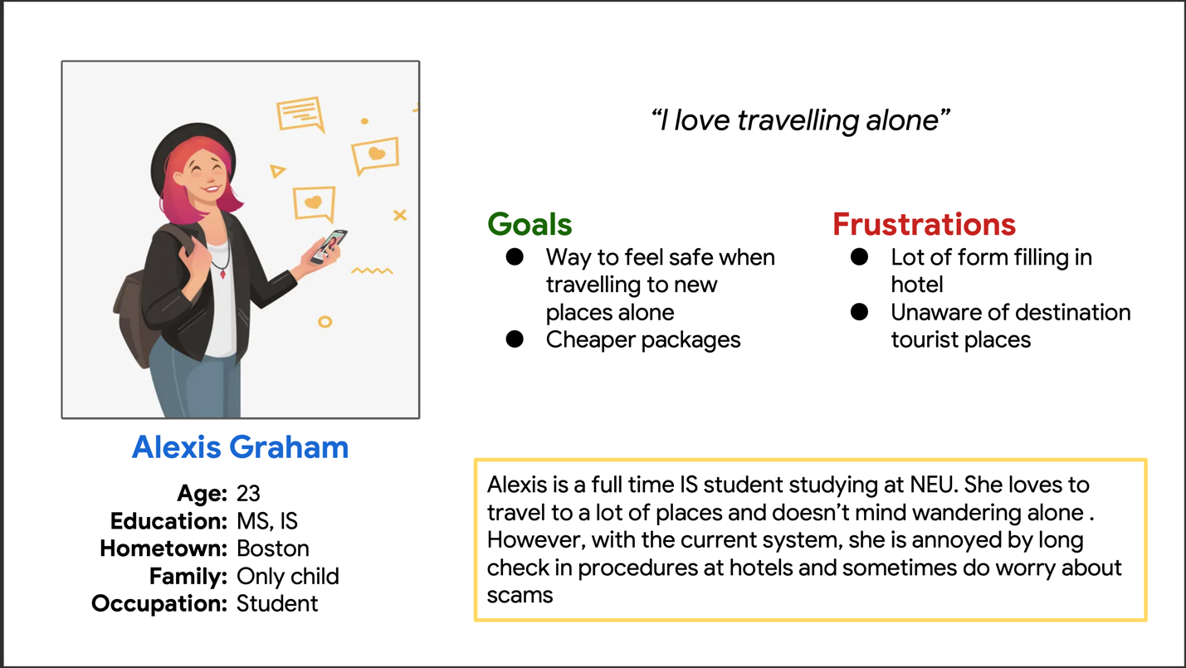
Persona 1

Slide 15
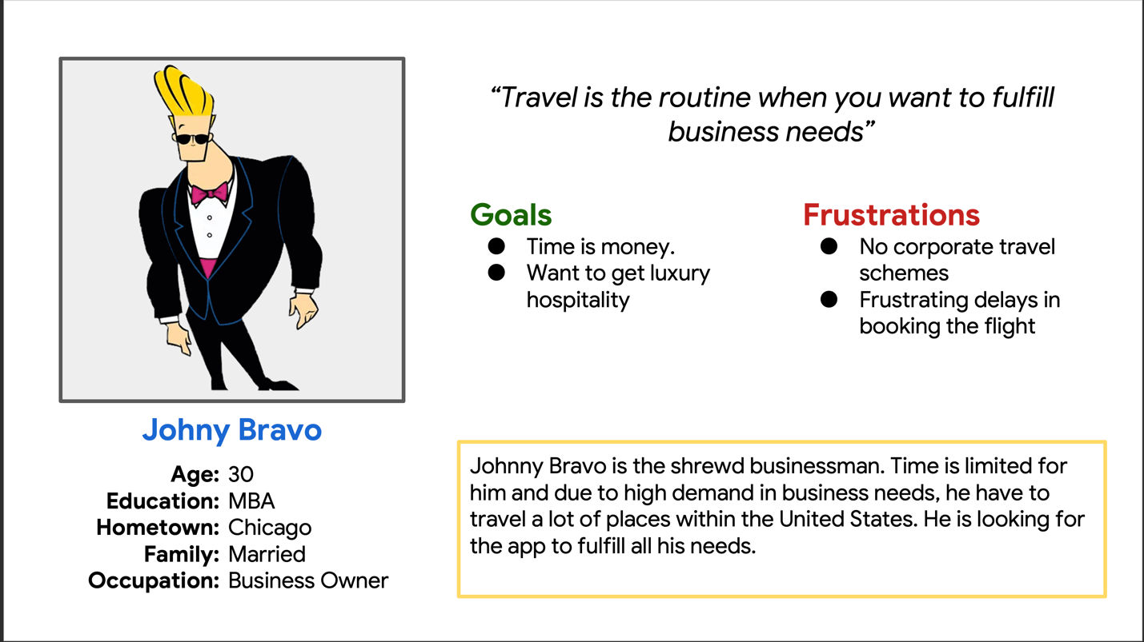
Persona 2

Slide 16
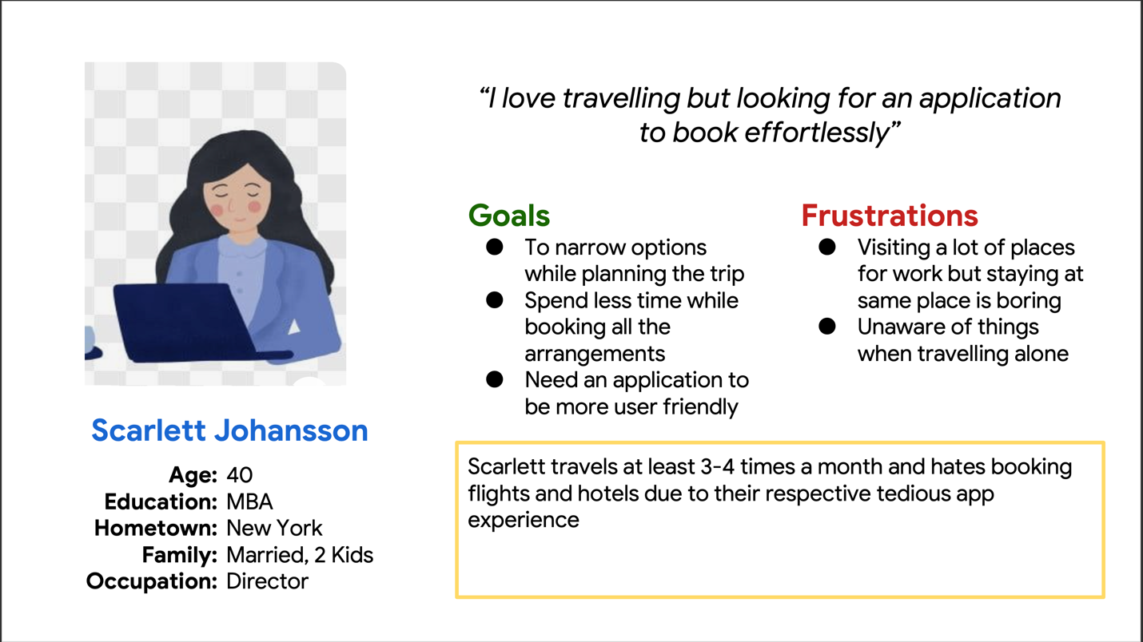
Persona 3

Slide 17
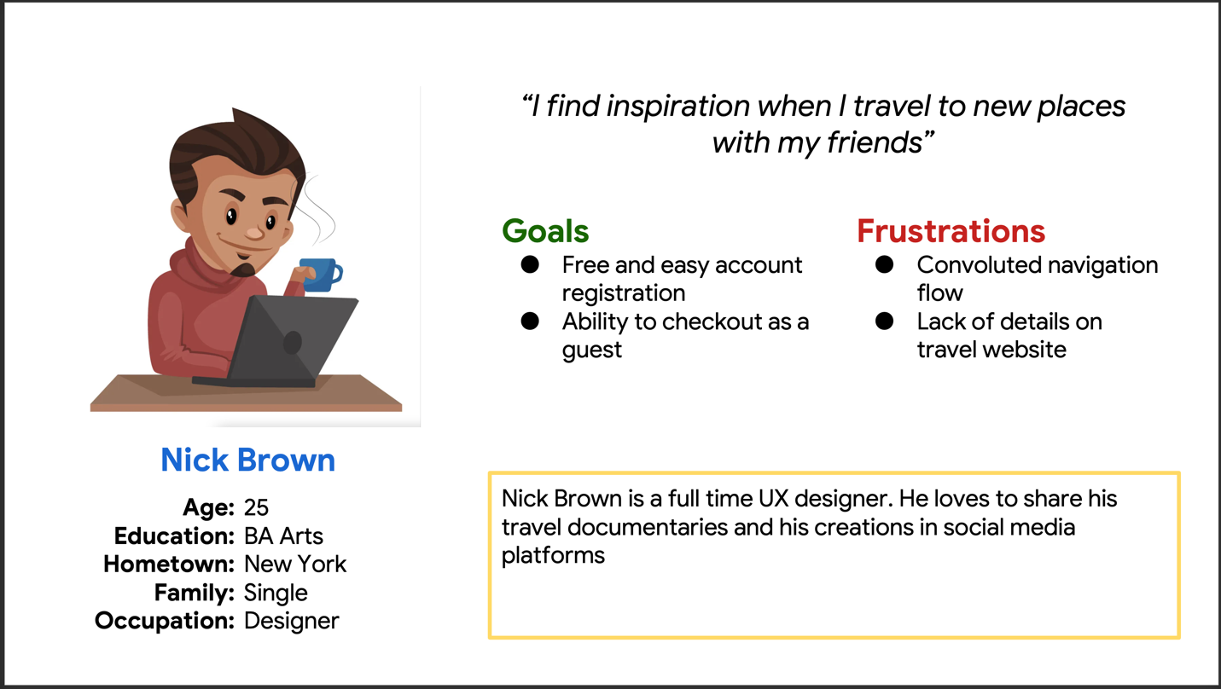
Persona 4

Slide 18
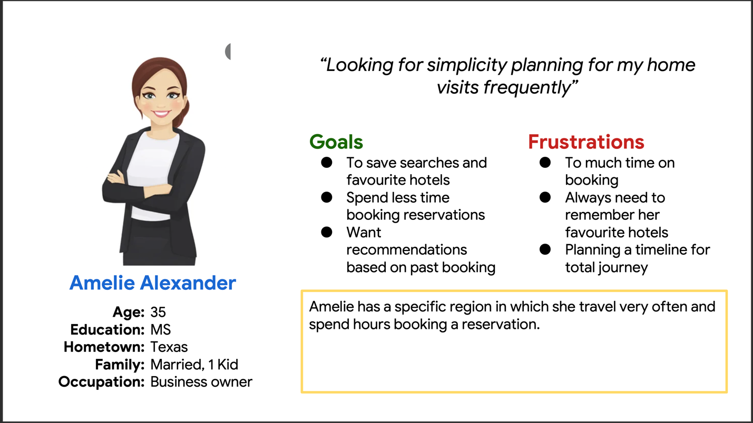
Persona 5

Slide 19
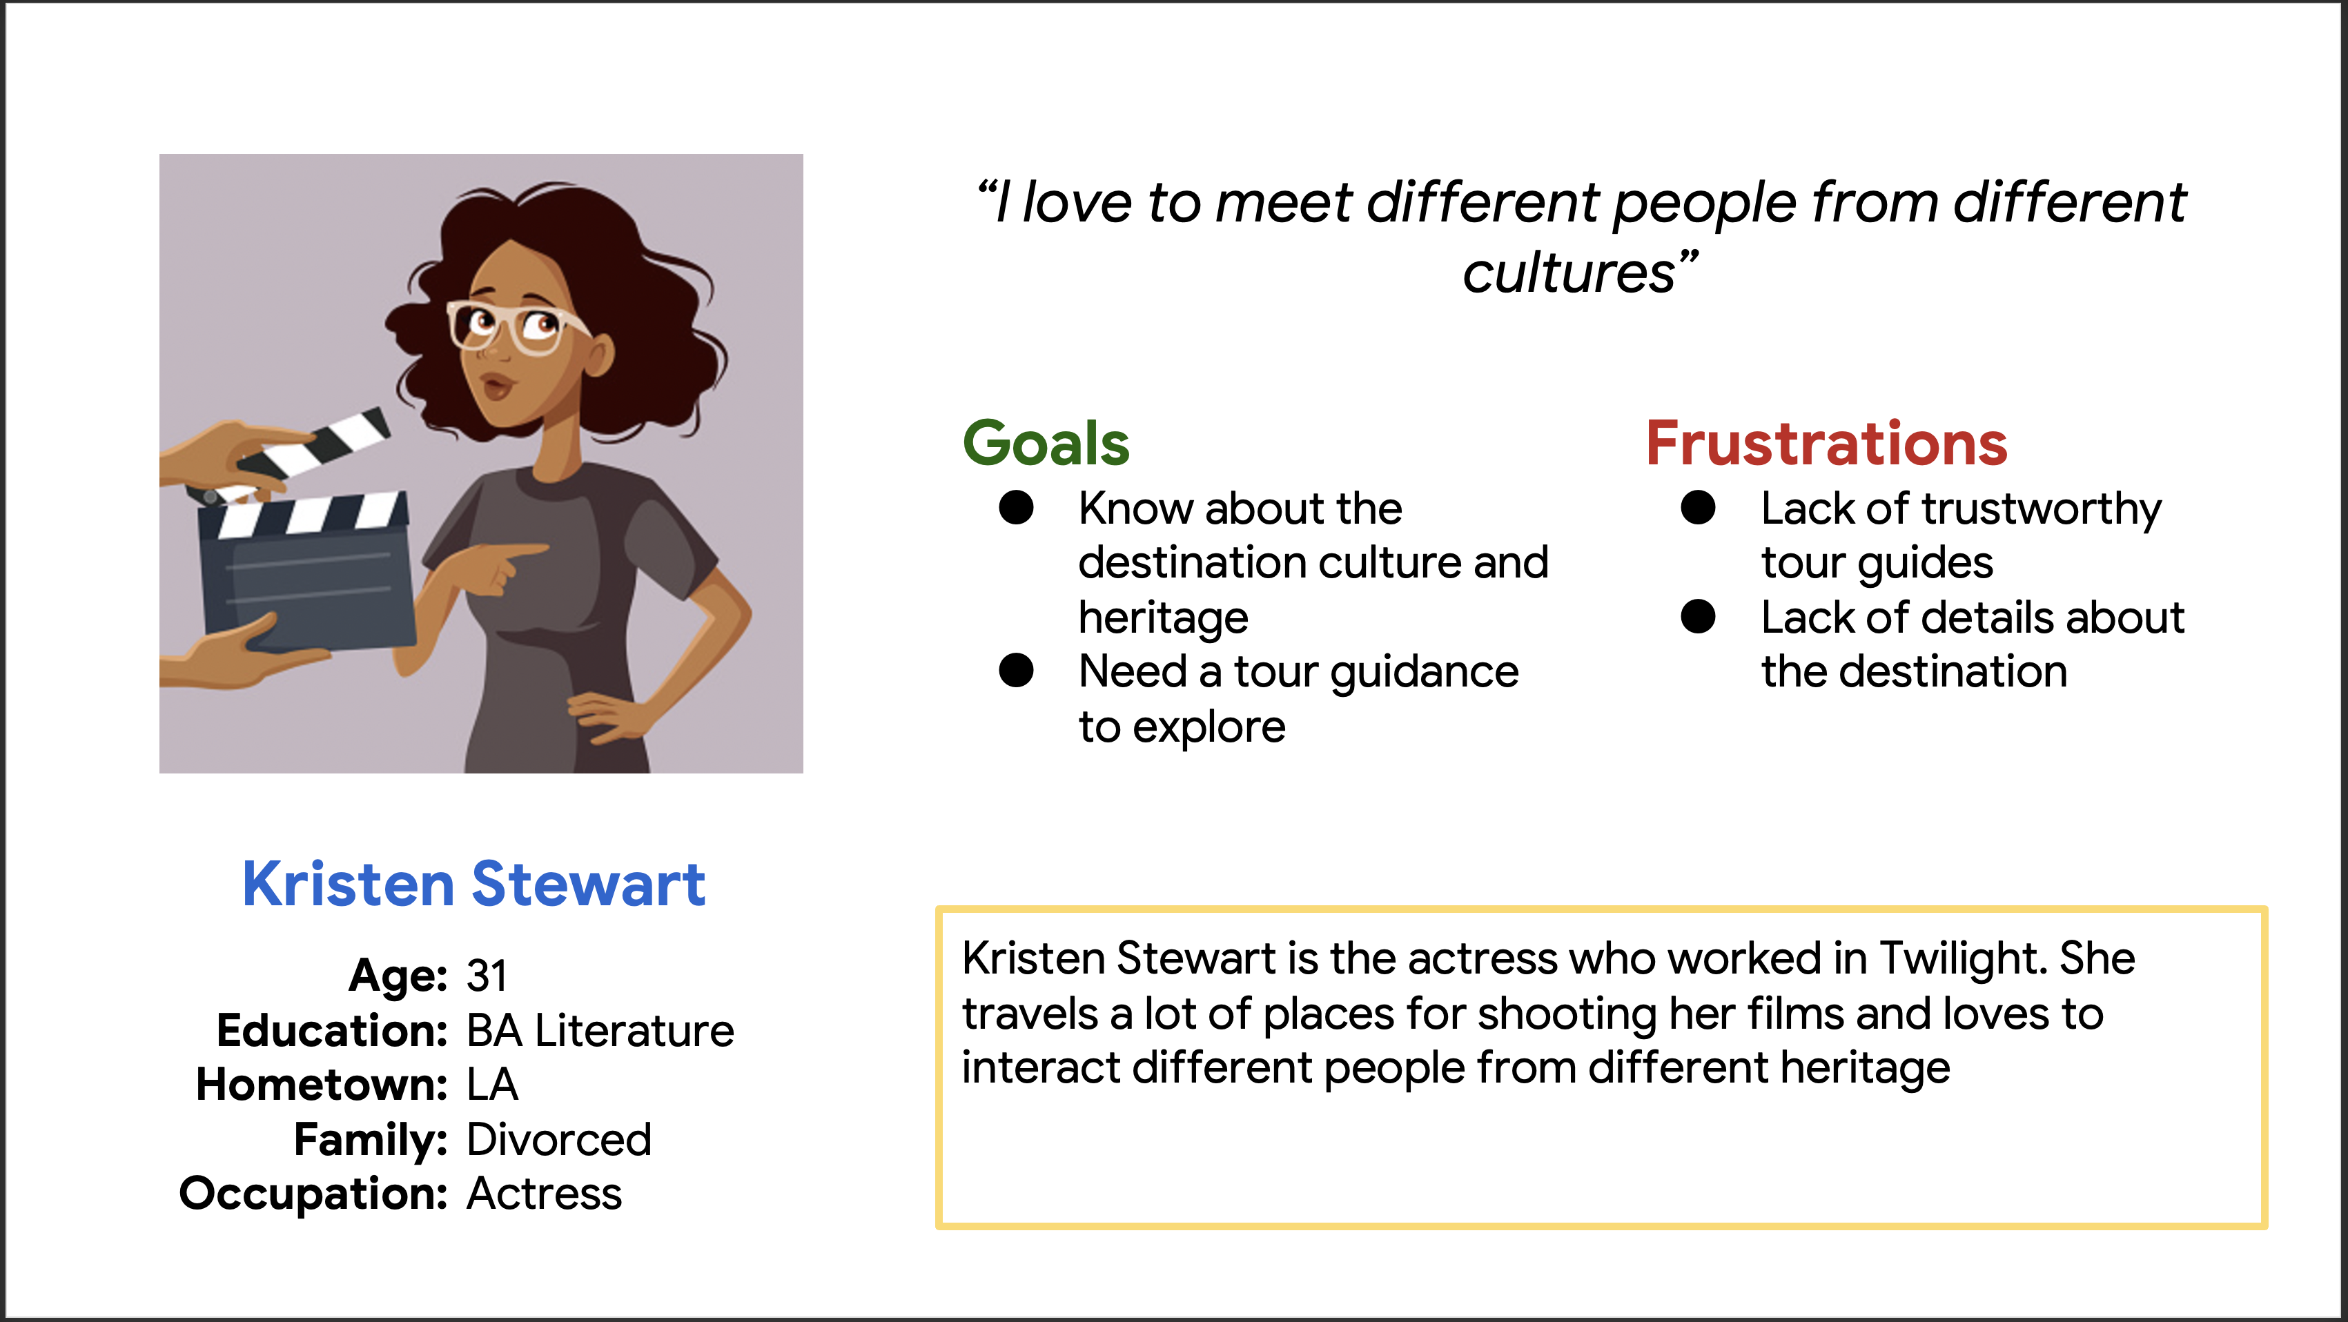
Persona 6

Slide 20

Use CASES

Slide 21
Use CASe 1 Heavy - Weight
Use Case 1 | Sign- in and browse through the application
Actor | User
Use Case Overview | The user wants to sign in and browse through the application. He/she can create an account which would enable him/her to login to the application. If he/she is an existing customer, he/she can sign in using his/her credentials. If the user does not want to sign up or if he/she does not have login created, he /she can continue as guest and enjoy the various options present within the application.
Subject Area | Web Application
Actor(s) | Users
Trigger | User want to browse the web application
Precondition 1 | User wants to browse and book travel tickets.
Precondition 2 | He should have internet connection.

Slide 22
Use CASe 1
Description | This scenario describes the situation user wants to login to the application and browse different travel packages/vacation packages. This is the main success scenario.
1 | The user wants to sign in and browse through the application.
2 | He/she can create an account which would enable him/her to login to the application.
3 | If he/she is an existing customer, he/she can sign in using his/her credentials.
4 | If the user does not want to sign up or if he/she does not have login created, he /she can continue as guest and enjoy the various options present within the application.
Termination outcome | User was successfully able to browse and look for the desired details.
Basic Flow: Sign- in and browse through the application

Slide 23
Use Case 1
Description | This scenario describes the situation in which the user notices that he/she does not have an account . He/she can create an account which would enable him/her to login to the application.
4A1 | User verifies that the he/she does not have an existing account associated with an email ID.
4A2 | User create a new account to login and browse the application.
Termination outcome | User was successfully able to browse and look for the desired details.
Alternative Flow 4A: Sign-up and browse through the application

Slide 24
Use Case 1
Description | This scenario describes the situation in which the user has an existing account, and he/she uses it to login to the application which would enable him/her to login to the application.
4B1 | User login to the application using the existing account.
4B2 | User browses through the application to explore different options.
Termination outcome | User was successfully able to browse and look for the desired details.
Alternative flow 4B: Sign- in using existing account and browse through the application

Slide 25
Use Case 1
Description | This scenario describes the situation in which the user does not want to sign up for the application but wants to browse through the application.
4C1 | User uses the option of continue as Guest to enter into the application.
4C2 | User browses through the application to explore different options.
Termination outcome | User was successfully able to browse and look for the desired details.
Alternative flow 4C: Sign- in as a guest and browse through the application

Slide 26
Use Case 1
Post conditions: User was successfully able to browse and look for the desired details.
Business Rules: User should be able to login successfully and able to browse and look for the desired details.

Slide 27
Use Case 2 Middle Weight
Use Case 2 | Safe and cheaper travel options
Actor | User
A user can log in to the website for ad-free content and then select the preferred travel destination which shows the list of available flights sorted by price. The user will also have the option to sort based on popular flights.
Alternative Flow 1 | User can go to plan trip section where he/she will enter the travel destination and can get the different quotes and plans available. Plans from start to end which includes flight tickets, stay, places to visit, etc.
Alternative Flow 2 | User can got to plan your own trip section where he/she will plan their own travel by checking options like different flights available, stay options and other things.

Slide 28
Use Case 3 Basic Weight
Use Case 3 | Travel based on business needs
Actor | User
Basic Flow | A frequent traveller can sign up for Elite membership plan which auto populates the list of previous destination that the user has travelled. Once the user picks the location, the application automatically shows the next available flight with the cheapest cost for economy and business class. The traveller information and the payment details gets auto-populated, and the user can confirm the booking in just 3 clicks.

Slide 29
Use Case 4 Basic Weight
Use Case 4 | Book travel itinerary effortlessly
Actor | User
Basic Flow | A user can sign up for a frequent traveller account which enables a user save the traveller information and payment card details. The user can book the flight in a quicker manner after selecting the optimal flight based on the destination.

Slide 30
Use Case 5 Middle Weight
Use Case 2 | Group tour options
Actor | User
User wants to plan a group trip along with family/friends. They can plan their group trip on our website
Alternative Flow 1 | User can search the plan available for group trips. Discounts will be provided since it is a group. User can get the quotes and plan which are already designed by our website.
Alternative Flow 2 | User can design and customize their own plan for their whole group. They can select multiple options while booking based on their requirements.

Slide 31

Thank you

